Slide 1
CS174A Lecture 12

Slide 2
Announcements & Reminders
2/25/24: A3 due; will be discussed during this week’s TA session
3/0306/24: A4 due; will be discussed during this week’s TA session
Team Project Timelines: see project info document on Canvas
Team project grade increased from 150 to 175 (download latest team project info)
3/19/24: Final exam, 6:30-8:3015 PM, in person, location TBD
Final exam grade reduced from 150 to 125 (download latest syllabus)
Study guide and book exercises posted
3/18 & 3/19: Office hours, Noon-1PM

Slide 3
TA Session This Next Friday
Team project proposals
Assignment #4
Gouraud and Phong shadings
Illumination

Slide 4
Last Lecture Recap
Illumination: ambient, diffuse, specular

Slide 5
Next Up
Flat and Smooth Shading
Barycentric Coordinates, Bilinear Interpolations
Mappings: Texture, Bump, Environment, Displacement
Hidden Surface Removal
2-pass z-buffer algorithm (shadows)
Ray casting

Slide 6
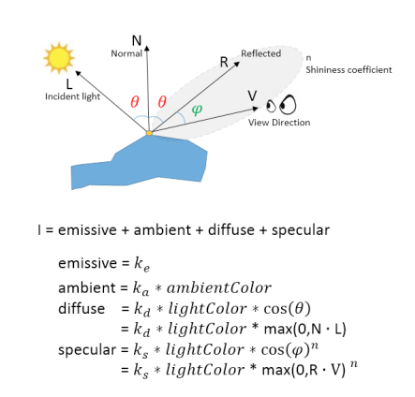
Light Equation
Illumination Recap
Occurs in WS or ES, not in PS
Need location and normal
Pick a point on poly
Light Color = Light Intensity
Add object color to amb and diff, not to spec
Attenuate light intensity based on distance to point
Add fog based on distance to eye
Material vs Geometric properties
Clamp or normalize colors
Advantage of doing in ES
Which point to pick on poly?

Slide 7
Polygon vs. Vertex Attributes
Polygon Attributes
Color
Normal
Vertex Attributes
Coordinates (position)
Color
Normal
Texture coords

Slide 8
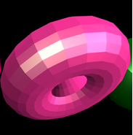
Flat or Constant or Faceted Shading
Use N of poly
Find I at center or at any vertex of poly
Apply that same color to all points inside poly
In essence, it means:
N is constant across poly
Light is at ∞ ⇒ N·L is constant across poly
Viewer is at ∞ ⇒ N·V is constant across poly
Which space to compute N and illuminate?
Either WS or ES, not in PS

Slide 9
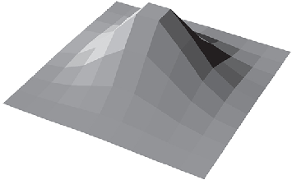

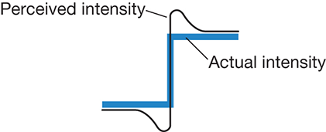
Problem with Flat Shading
Mach bands is an optical illusion named after the physicist Ernst Mach. It exaggerates the contrast between edges of slightly differing shades of gray, as soon as they contact one another, by triggering edge-detection in the human visual system. https://www.youtube.com/watch?v=sItlLNhhiLg

Slide 10
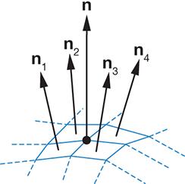
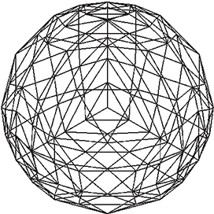
Gouraud Smooth Shading
Also called “Intensity” interpolation or “Color” interpolation shading
WS: Find I at each vertex and illuminate vertex
SS: Interpolate across poly face
Store normals @ vertices
Average normals of polys sharing vertex
During tessalation, e.g., sphere
What about hard edges?

Slide 11
Gouraud Smooth Shading
Issues with Gouraud Shading
Thin polygons
Rotating polygons
Specular reflection with large polygons
At poly’s center
At poly’s vertex
Mach banding not completely eliminated

Slide 12
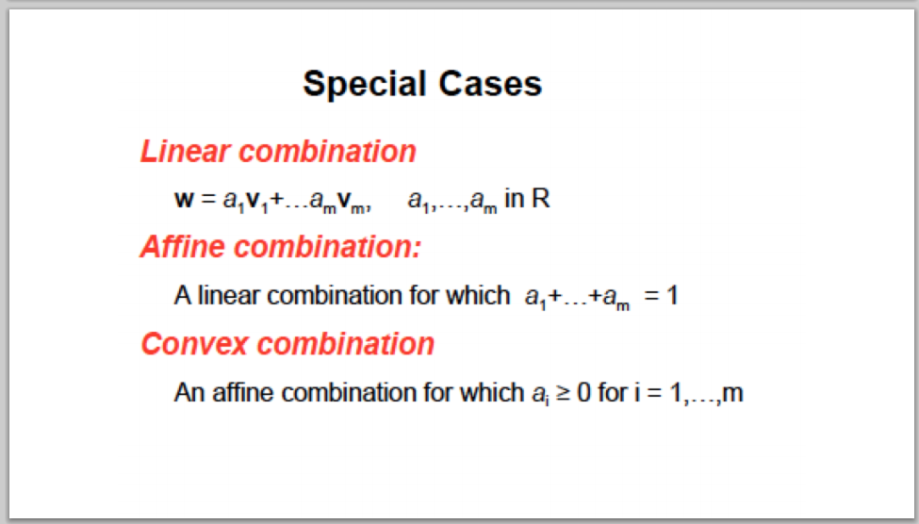
Recall: Interpolation Formulas

Slide 13
Barycentric Interpolation
t=0
t
x₁
t=1
x₂
The further t is from the red point, the more blue we want. The further t is from the blue point, the more red we want.
Percent blue = t
Percent red = 1-t
Value at t = (1-t)*x₁+ t*x₂

Slide 14
Barycentric Interpolation
Just like before:
percent red
= area of red triangle
total area
percent green = area of green triangle
total area
percent blue
= area of blue triangle
total area
p

Slide 15
Barycentric Interpolation
Just like before:
percent red
= area of red triangle
total area
percent green = area of green triangle
total area
percent blue
= area of blue triangle
total area
Value at p:
(% red)(value at red) +
(% green)(value at green) +
(% blue)(value at blue)
p

Slide 16
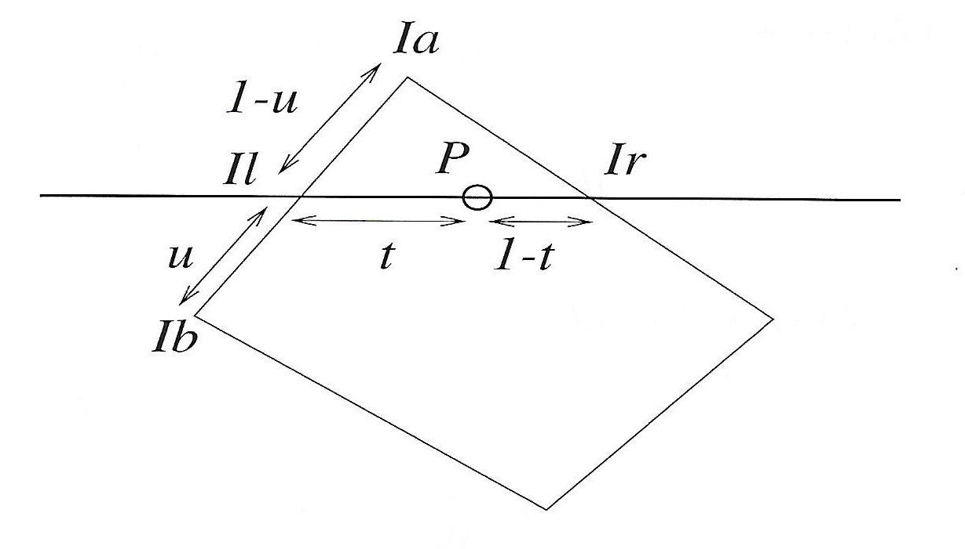
Bilinear Interpolation
Can be used to interpolate z, color, normal, texture, etc.
Interpolate along 2 edges
Interpolate along scanline
Incremental calculations

Slide 17
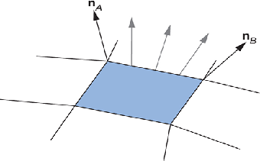
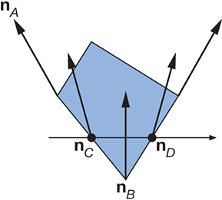
Phong Smooth Shading
Also called “Normal Vector” interpolation shading
Calculate intensity at each pixel
Interpolate normals similar to others, then normalize
Much more computation, but much better looking images

Slide 18
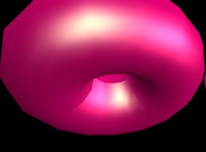
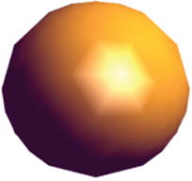
Smooth Shadings
Issues with interpolated shading
Polygon sillouhette
Orientation dependence (triangles ok)
Problems at shared vertices
Unrepresentative vertex normals

Slide 19
Shading Recap
Flat Shading
Illuminate a poly only once
No interpolation
Gouraud Shading
Illuminate vertices of poly
Interpolate colors at vertices
Phong Shading
Illuminate each point inside poly
Interpolate normals at vertices
Illumination in WS/ES, interpolation in SS

Slide 20
Flat vs Smooth Shading
Problem with this step:
Distribute it to all three vertices identically
What if some vertices are shared by more than one triangle?
Could happen when we are summarizing our triangles using lists of “indices” into a list of (non-repeating, unique, more compact) vertices

Slide 21
Flat vs Smooth Shading
What if some vertices are shared by more than one triangle?
A vertex can’t have two normals at once, logistically!
Other triangles will fight over assigning normals to a vertex
Conclusion: Sometimes we should put repeats in our vertex list. We shouldn’t try to re-use indices at seams.
Instead, store extra/duplicate vertices at a position, with differing normals.

Slide 22
GuerrillaCG Series: Flat vs Gouraud Shading
https://youtu.be/PMgjVJogIbc?t=6
For this to work, shapes must be modeled a certain way (“seams”)
Must store multiple vertices touching the same position
Must be able to store conflicting normal data even if position data matches

